Slide 1
Deep Learning on Graphs
Part 2
Michael Kenning, Stavros Georgousis​

Slide 2
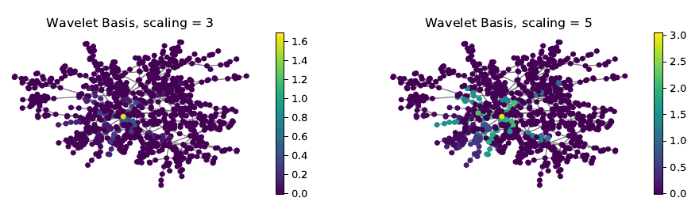
Spectral Convolution cont.
Same objective as spatial convolution
(Theoretically) no problem with neighbourhood selection.
Signal diffused from central node.
Cons -> Computationally expensive
Source: Xu et al. 2019

Slide 3


Spectral Convolution cont.
Idea of spectral convolution:
Project graph signal to spectral domain
Filter in spectral domain.
Get a new feature representation in vertex (spatial) domain.

Slide 4



Example: Spectral Convolution (Bruna et. al., 2014)
Fourier transform -> U = eigenvectors of L:
Convolution defined as:
Layer implementation:
Computationally expensive: O(n^2)

Slide 5



Example: ChebNet (Defferard et al., 2016)
Calculation of eigenvalue decomposition computationally expensive
Solution -> approximate the Fourier transformed signal (Chebyshev polynomials)
Approximate !

Slide 6




Example: Graph Convolution Network (GCN) (Kipf et al., 2017)
Where we left off:
Approximate !
Renormalisation trick
Computationally efficient (well… relatively)
Neighbourhood order: 1
Basically the baseline standard
Curious case (could be said it isn’t spectral)

Slide 7
Graph Pooling
Global pooling (readout):
Summarises features for graph level tasks
No equivalent in CNNs
Hierarchical pooling:
Analogous to standard pooling in CNNs
Dilates receptive field
Can improve performance using hierarchical representation

Slide 8
Global pooling (readout layer)
Min, max, mean, sum pooling
Combinations of above mean + max pool (Ying et al., 2018)
Interesting example: SortPool (Zhang et al., 2019)
Sort
Concatenate

Slide 9









Hierarchical Pooling
Subsampling based
Pros -> Efficient
Cons -> Discard information, potentially isolated vertices
Clustering based
Common caveat: pooled graph dense

Slide 10
Subsampling based pooling
Examples: Top-K pooling (Graph U-Nets, SAGPool)
Score
Sort
TopK

Slide 11

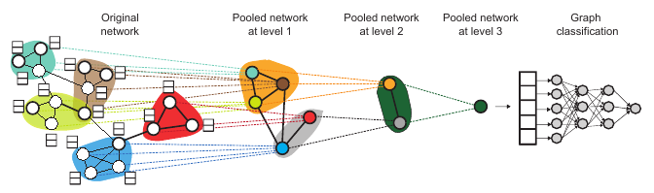




Clustering based pooling
Common approach learning a clustering assignment matrix, S
Source: Ying et al. 2019

Slide 12
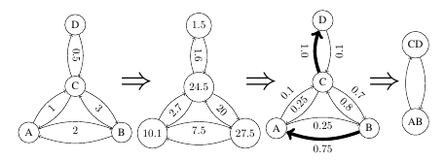
Example: Edge Pooling
Selects edges to be contracted based on edge scores.
Pros: Retains sparsity

